Slide 1
Crop Production Analysis in India

Slide 2
Introduction
Objective:
To predict crop production in India and identify the key factors influencing it.
Dataset:
Detailed crop production data over several years.
Significance:
Improving decision-making for stakeholders in the agri-food supply chain.

Slide 3
Details of Data
Following is the data provided to do analysis on :-
This dataset provides a huge amount of information on crop production in India ranging from several years.
Based on the Information the ultimate goal would be to predict crop production.
Find important insights highlighting key indicators and metrics that influence crop production.

Slide 4
Main KPIs
Total Production and Area used.
Season wise how much production is done.
Which district has maximum crop production.

Slide 5
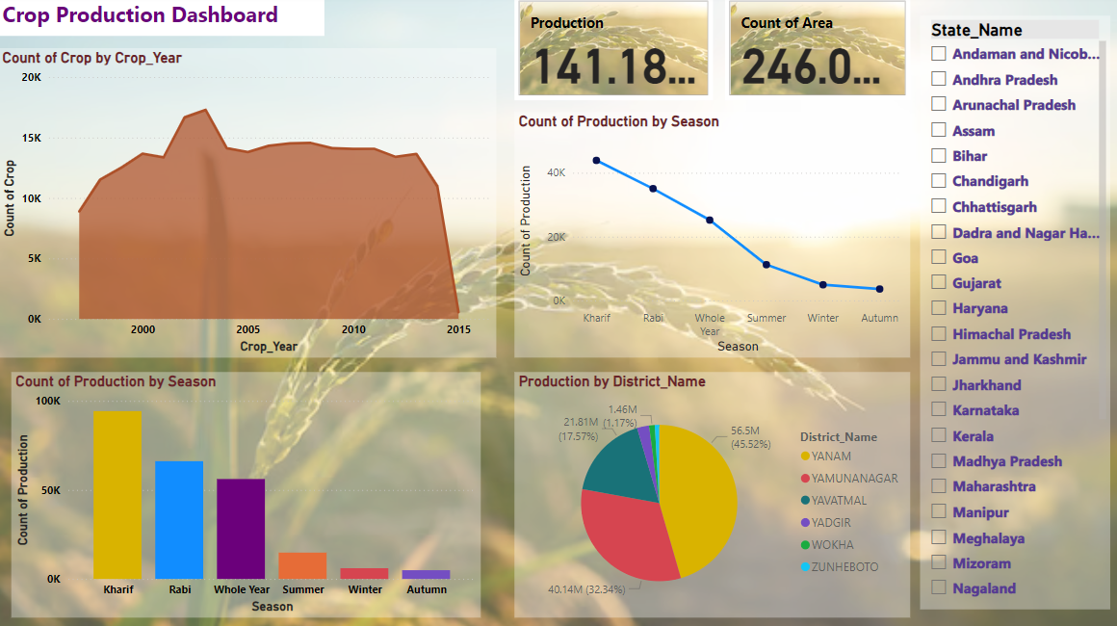
My Design

Slide 6
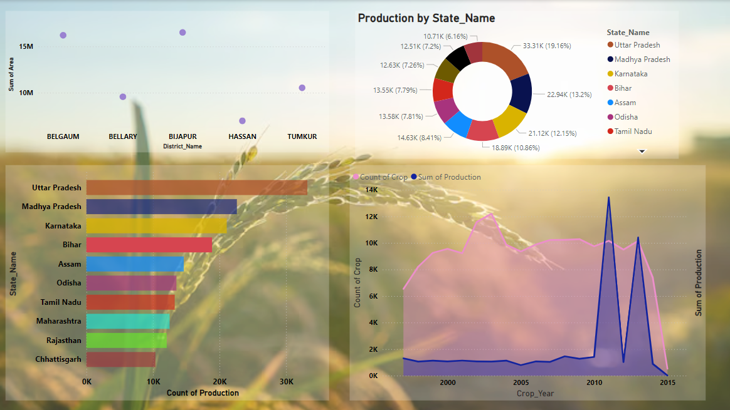

Slide 7
Thank You

